Slide 1
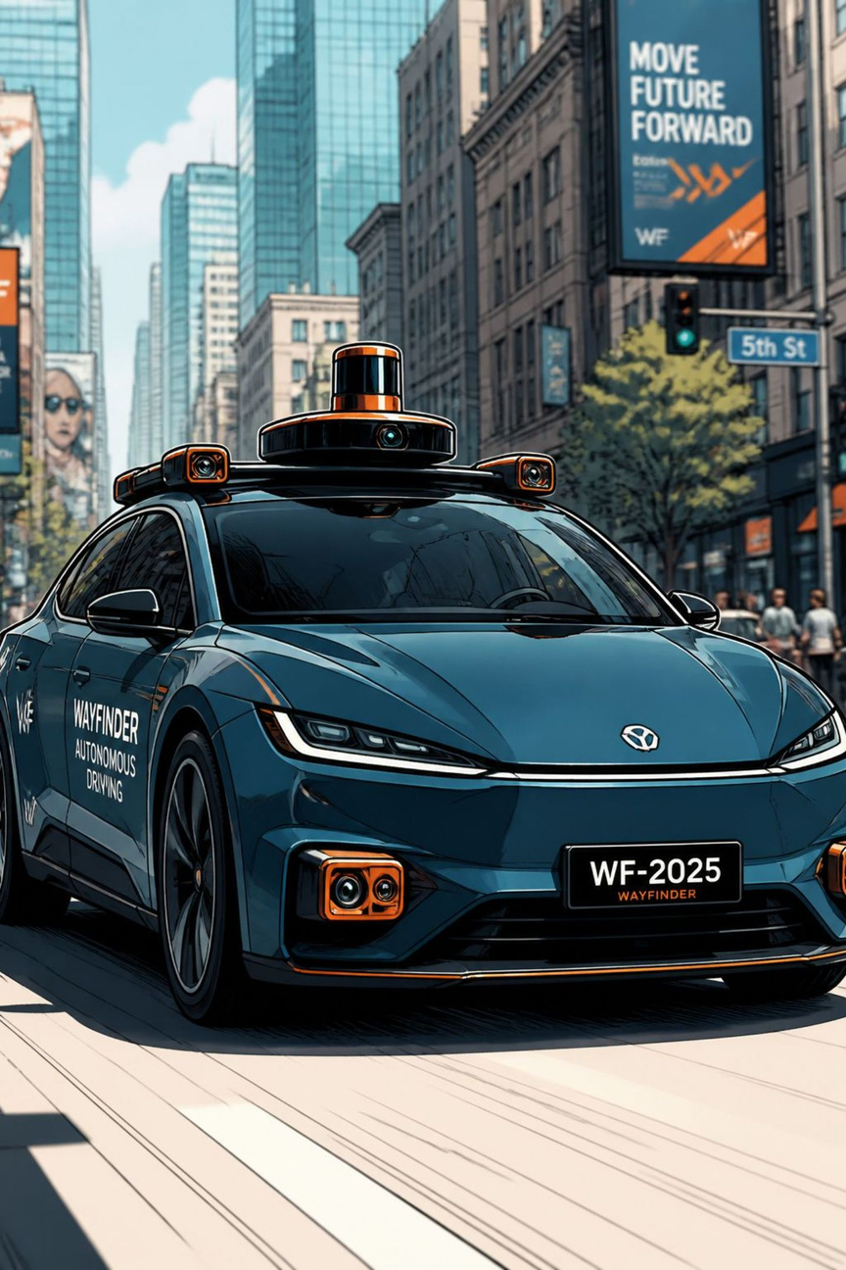

Synchronization Issues in Multi‑Camera Systems
Presented By
K Florina
192521479
1
Notes:
1

Slide 2
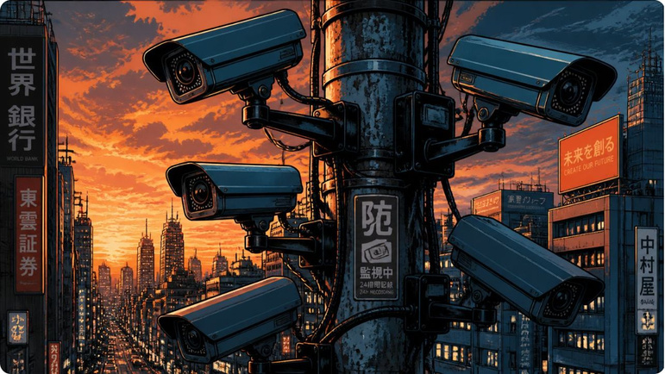
What is a Multi‑Camera System?
Two or more cameras capture the same scene from different viewpoints and cooperate to improve perception. Common goals:
Wider field of view
Improved object detection and redundancy
3D reconstruction and depth estimation
Robust multi‑object tracking
Typical applications: self‑driving cars, CCTV surveillance, robotics, sports analytics (Hawk‑Eye), and smart factories.
2
Notes:
2

Slide 3
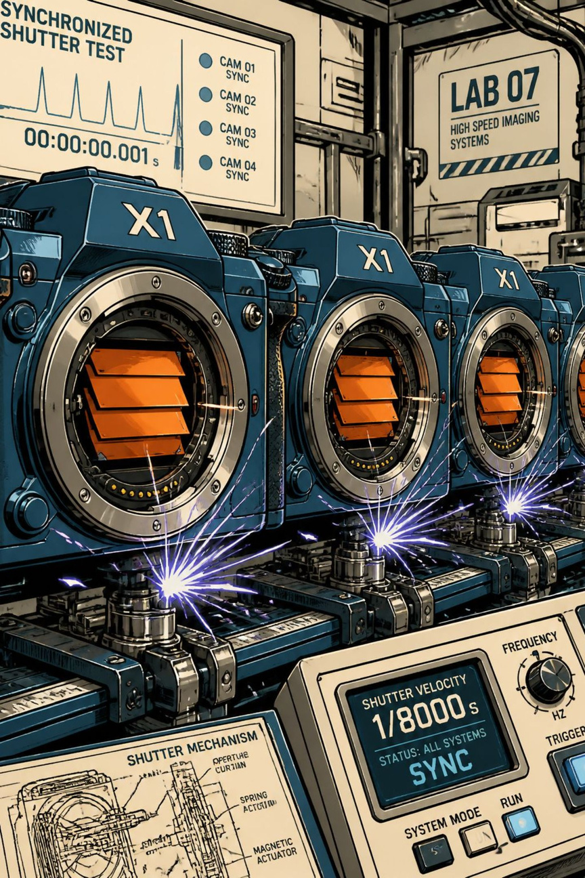
What is Synchronization?
Synchronization means all cameras capture frames at the same instant so images represent a single physical moment. It is essential because downstream algorithms fuse multi‑view inputs assuming temporal alignment.
Temporal alignment
Frames share the same timestamp to avoid motion mismatch.
Consistent inputs
Ensures reliable triangulation, tracking and sensor fusion.
3
Notes:
3

Slide 4
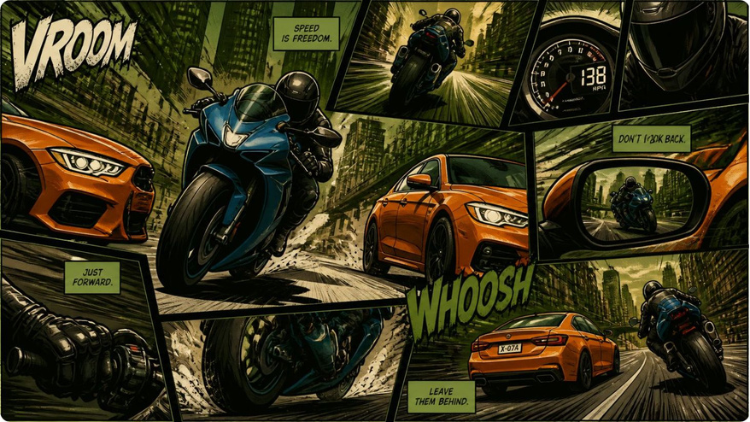
Why Poor Sync Breaks Vision Systems
When cameras are unsynchronised, the system may combine images of different instants. Consequences:
Incorrect object positions → bad localisation
Fragmented tracks and identity switches
Depth and distance estimation errors
Poor decisions in safety‑critical systems (e.g., braking)
4
Notes:
4

Slide 5
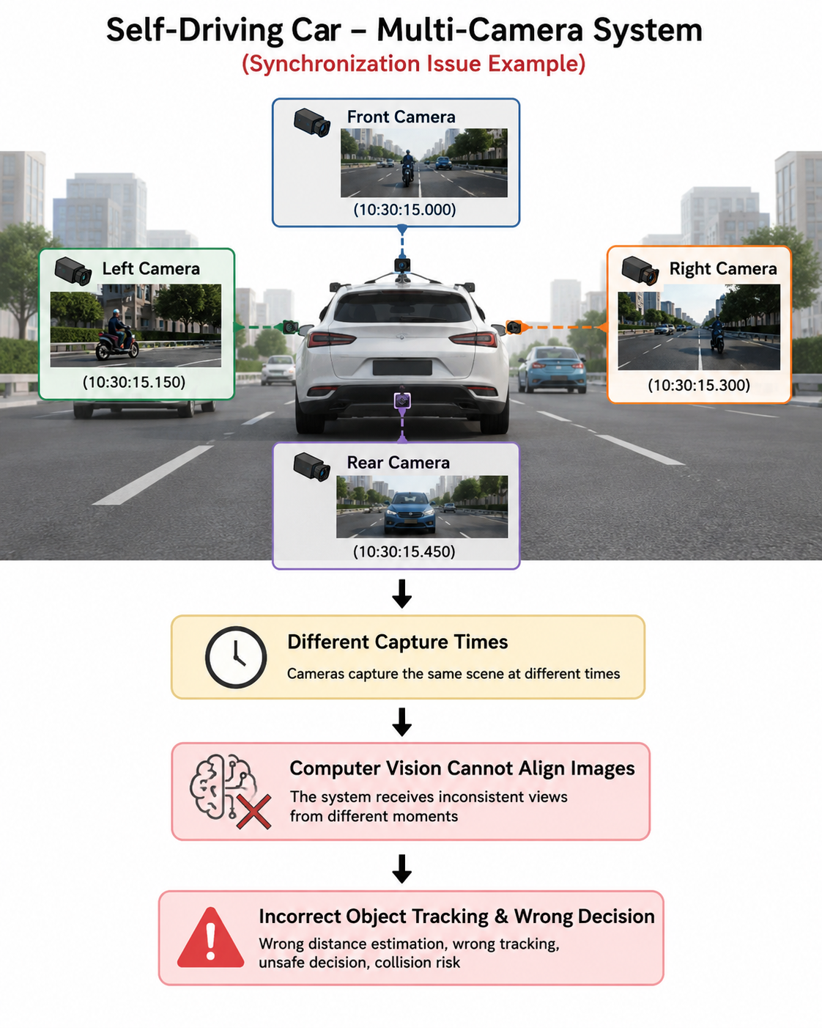
Real‑World Example: Self‑Driving Car
Scenario: motorcycle approaches and passes the vehicle. If cameras are not synchronous:
Front view shows motorcycle ahead
Left view shows motorcycle alongside
Rear view shows motorcycle already past
Fused perception can be inconsistent → track fragmentation, incorrect collision risk estimates and potential control errors.
5
Notes:
5

Slide 6
Common Causes of Synchronization Issues
Time delay / latency
Frame mismatch
Varying frame rates
Capture or transmission delays between cameras create temporal offsets.
Different frame counters or dropped frames break alignment.
30 FPS vs 60 FPS requires careful alignment or interpolation.
Clock drift
Network jitter
Independent internal clocks diverge over time without correction.
Packet delays or reordering affect timestamps and delivery timing.
6
Notes:
6

Slide 7
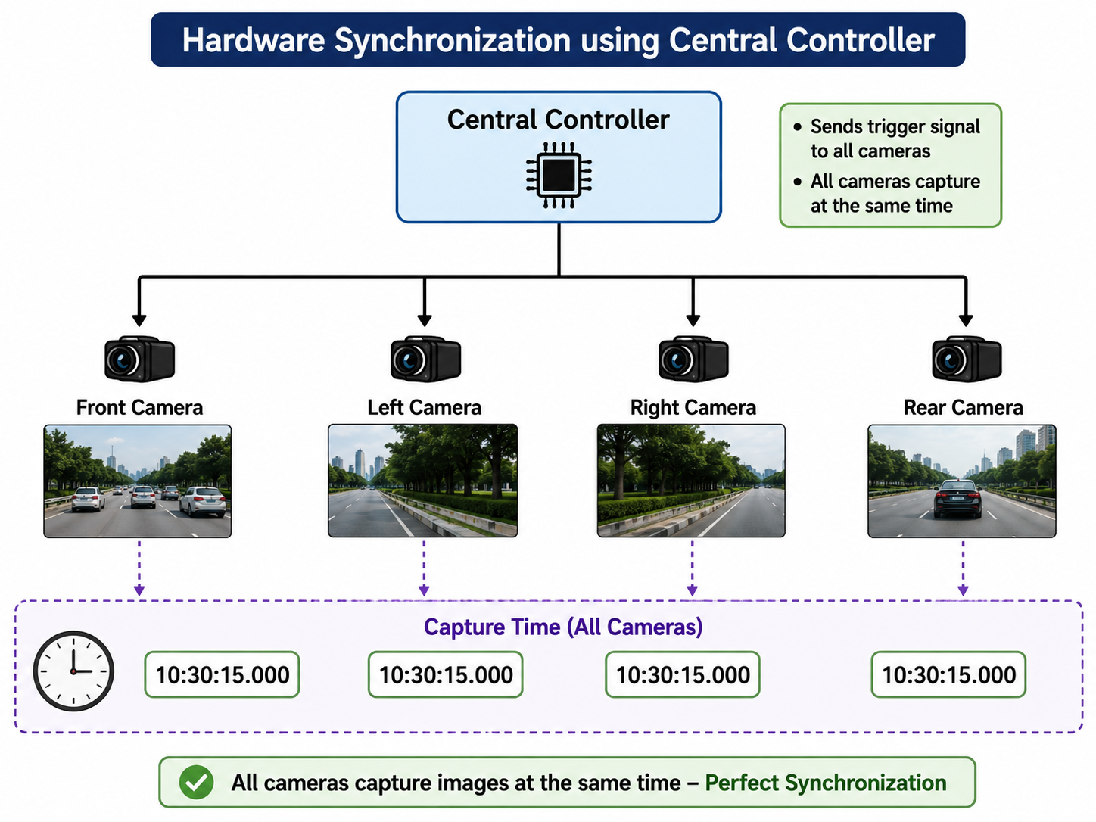

Hardware Solutions
Primary hardware strategies:
Central trigger: single pulse drives synchronized exposure across all cameras.
Genlock / hardware clock distribution: share a stable reference clock to eliminate drift.
Wired capture: low‑latency cabling reduces network jitter and packet loss.
Hardware sync provides the strongest temporal guarantees for safety‑critical systems.
Notes:
7

Slide 8
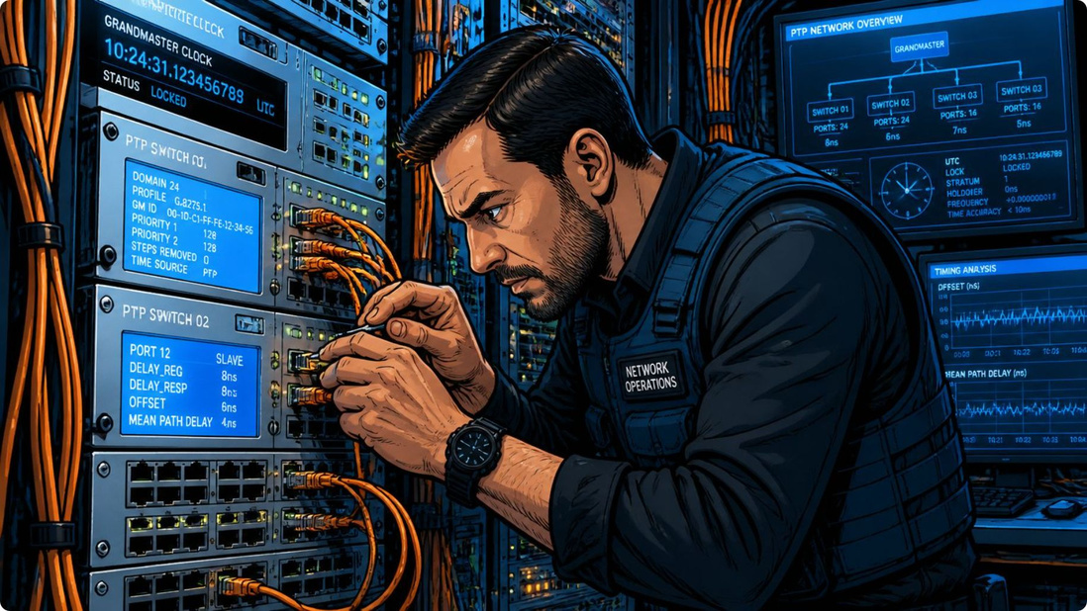
Software & Network Techniques
When hardware sync is unavailable or as a complement:
NTP
Network Time Protocol — coarse clock alignment over networks (ms level).
PTP
Precision Time Protocol — sub‑millisecond accuracy on supported networks.
AI‑based alignment
Post‑hoc frame alignment using feature matching, optical flow or learned temporal models.
8
Notes:
8

Slide 9

Best Practices & Engineering Checklist
1
Define accuracy target
Validate in situ
Monitor & compensate
Specify required temporal tolerance (e.g., ±1 ms) based on object speed and system safety margins.
Run end‑to‑end tests with moving objects to measure temporal error and perception quality.
Continuously monitor timestamps, detect drift, and apply software correction when needed.
2
Prefer hardware sync
Use central triggers or Genlock for mission‑critical deployments.
3
Use PTP over NTP
Graceful degradation
Where networked devices are required, implement PTP and test under load.
Design perception to fall back safely if sync quality degrades (wider safety margins, reduced autonomy).
9
Notes:
9

Slide 10
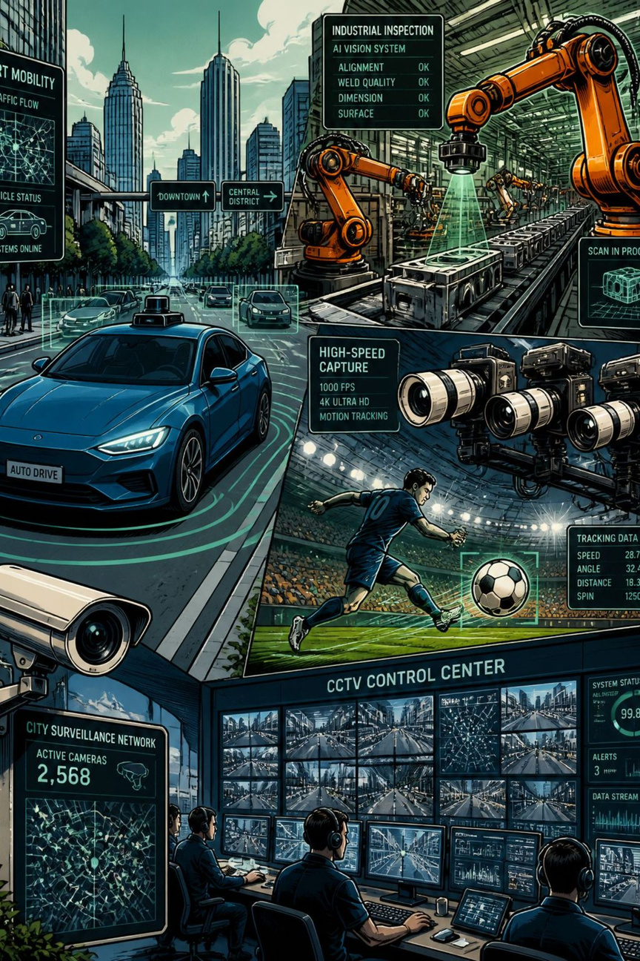
Conclusion — Why Synchronization Matters
Multi‑camera systems significantly enhance perception, but only if frames are temporally aligned. Proper sync (hardware + network + software validation) yields:
Accurate object detection and reliable tracking
Correct distance and 3D reconstruction
Improved safety and decision‑making in autonomous systems
Next steps: decide sync architecture for your project, specify tolerance, and build a validation plan.
10
Notes:
10

